Slide 1
A concept of environmental forecasting and variational methods for its implementation
Vladimir Penenko
Institute of Computational Mathematics and Mathematical Geophysics SD RAS
Novosibirsk

Slide 2
From nuclear reactors and perturbation theory...
ГНЦ РФ – Физико-энергетический институт (ФЭИ) всемирно известен не только благодаря Первой в мире АЭС;
визитная карточка института – реакторы на быстрых нейтронах.
Physics –energy institute is known worldwide not only for the world's first nuclear power plant;
the business card of the Institute are fast neutron reactors.
G.I. Marchuk Numerical methods for calculation of nuclear reactors - Atomizdat, Moscow, 1958
G.I. Marchuk Computational methods for nuclear reactors - Atomizdat, Moscow, 1961

Slide 3
A mathematical model for calculating multi-group nuclear reactors
The basic system of equations
Geometry:
Boundary conditions:
neutron distribution function
the largest eigenvalue of the problem
non-negative matrices of diagonal form

Slide 4
Main studies
Direct problems
The calculation of the critical parameters of reactors
Adjoint problems for goal functional assessments
The calculation of the relations of perturbation theory for the various functionals
Parameters of the modeling system
material regions
The number of zones in the reactor:
space regions
Marchuk G.I.,Penenko V.V. Multi-group calculations of 2D reactors , TR №565, 1964, Physics-energy institute, Obninsk
Industrial reactors were calculated with our models
from 1962 to 1974

Slide 5
Kinetic equations of radiation transport
G.I. Marchuk, V.V. Penenko, U.M. Sultangazin On the solution of kinetic equations with splitting method// In: Some issues of computational and applied mathematics. Novosibirsk, Nauka, 1966
A new class of numerical schemes has been developed for solving kinetic equations of radiation transfer. These methods are designed to calculate the emission processes in nuclear reactors, radiation in the atmosphere, etc.

Slide 6
...to atmospheric dynamics and environmental problems
G. I. Marchuk, The numerical solution of problems in the dynamics of the atmosphere and oceans (Gidrometeoizdat, Leningrad, 1974).
G. I. Marchuk, Mathematical Modeling in the Problem of Environment
(Nauka, Moscow, 1982).
G. I. Marchuk, Adjoint Equations and Analysis of Complex Systems (Nauka, Moscow, 1992).
V. V. Penenko, Methods for Numerical Modeling of Atmospheric Processes (Gidrometeoizdat, Leningrad, 1981).
V. V. Penenko and A. E. Aloyan, Models and Methods for Environmental Protection Problems (Nauka, Novosibirsk, 1985).
A. E. Aloyan, Modeling of the Dynamics and Kinetics of Gaseous Compounds and Aerosols (Nauka, Moscow, 2008).

Slide 7
Methods of orthogonal decomposition.
Subspaces of informative basis
G.I. Marchuk . Contribution to the theory оf biorthogonal expansions of the fields of meteorological elements // AKADEMIIA NAUK SSSR, DOKLADY, 1968
Spectral problems for forward and adjoint operators of atmospheric hydrodynamics to construct the informative bases
G.I. Marchuk, V.V. Penenko, A.V. Protasov. Few-parameter spectral-difference model of atmosphere dynamics// Russian Meteorology and Hydrology, 1978
Activity centers of the climatic system
Penenko V., Tsvetova E. Orthogonal decomposition methods for inclusion of climatic
data into environmental studies//Ecol. Model. V. 217. P. 279–291. 2008.

Slide 8
Two main components: model and data

Slide 9
Model of atmospheric dynamics
,
,
,
,
,
,
,
,
,
.

Slide 10
Convection-diffusion-reaction system
for humidity and gas - aerosol chemistry
Operators of transformation for chemical kinetics
destruction
production
! Important properties
Notes:
K – клнст скор реакций s – стехиометр коэфф q – что расходуется s_i стих коэфф иго уравнения – по отн к иму компоненту
10

Slide 11
Integral identity is a variational form of integrated system:
hydrodynamics+ chemistry+ hydrology
equation of the energy balance for the system
state vector;
adjoint vector
Notes:
Ro – ro_a вычисл по уравнению сост для влаги плотность можно вычислить двумя путями и потом их согласуем
11

Slide 12
Augmented functional for construction
of optimal algorithms and uncertainty assessment
cost functional
misfit in
observations
model’s uncertainty
initial data unc.
parameters unc.
integral identity
Penenko V. V. Variational methods of data assimilation and inverse problems for studying the atmosphere, ocean, and environment // Numerical Analysis and Applications, 2009 V 2 No 4, 341-351.

Slide 13
From theory of perturbations to sensitivity theory

Slide 14
Sensitivity studies
V.V. Penenko. Computational aspects of simulation of the dynamics of atmospheric processes and assessment of the impact of various factors on the dynamics of the atmosphere// In: Some problems of computational and applied mathematics (Ed. M.M. Lavrent’ev )–Novosibirsk, Nauka, 1975, 61-76.
Marchuk G.I., and Penenko V.V. Application of optimization methods to the problem of mathematical simulation of atmospheric processes and environment / Marchuk (ed.) // Modelling and Optimization of Complex Systems. Proc. IFIP-TC7 Working conf. Springer. New York. 1978. P. 240-252
G.I. Marchuk, V.V. Penenko . Study of the sensitivity of discrete models of atmospheric and oceanic dynamics// Atmospheric and Oceanic Physics, 1980

Slide 15
Variational methods to study the model sensitivity
Augmented functional of the modeling system ( discrete analog)
vector of the functional’s arguments,
sensing frequency
variations of
real parameter
The structure of sensitivity algorithms is based on the Gateaux derivatives
(P. Lévy, Problèmes concrets d'analyse fonctionnelle, Paris 1951)

Slide 16
P-order functional variations. Computational algorithms of sensitivity relations
Gateaux derivatives of the functional
Taylor's formula is valid
for each fixed function
provided
Taylor series for the functional
P=1: Euler-Lagrange equations; the systems of direct and adjoint equations, the uncertainty equations ; sensitivity relations to the variations of parameters
P=2: second order sensitivity relations; Gessian

Slide 17
Variations of the augmented cost functional ( p=1)
Stationary conditions
Sensitivity relations

Slide 18
The generic algorithm
of forward & inverse modeling

Slide 19
Some elements
of optimal forecasting and design
The main sensitivity relations
Sensitivity functions
Feed-back relations
are the sensitivity functions
are the parameter variations

Slide 21
...to Variational data assimilation
First generation of data assimilation algorithms , 1976-...
Perfect model, variational principle with strong restrictions;
reconstruction of the initial data
Second generation, 1985-....
Model with uncertainty, weak-constraint variational principle
Third generation , 2009-.....
New algorithms without iterations

Slide 22
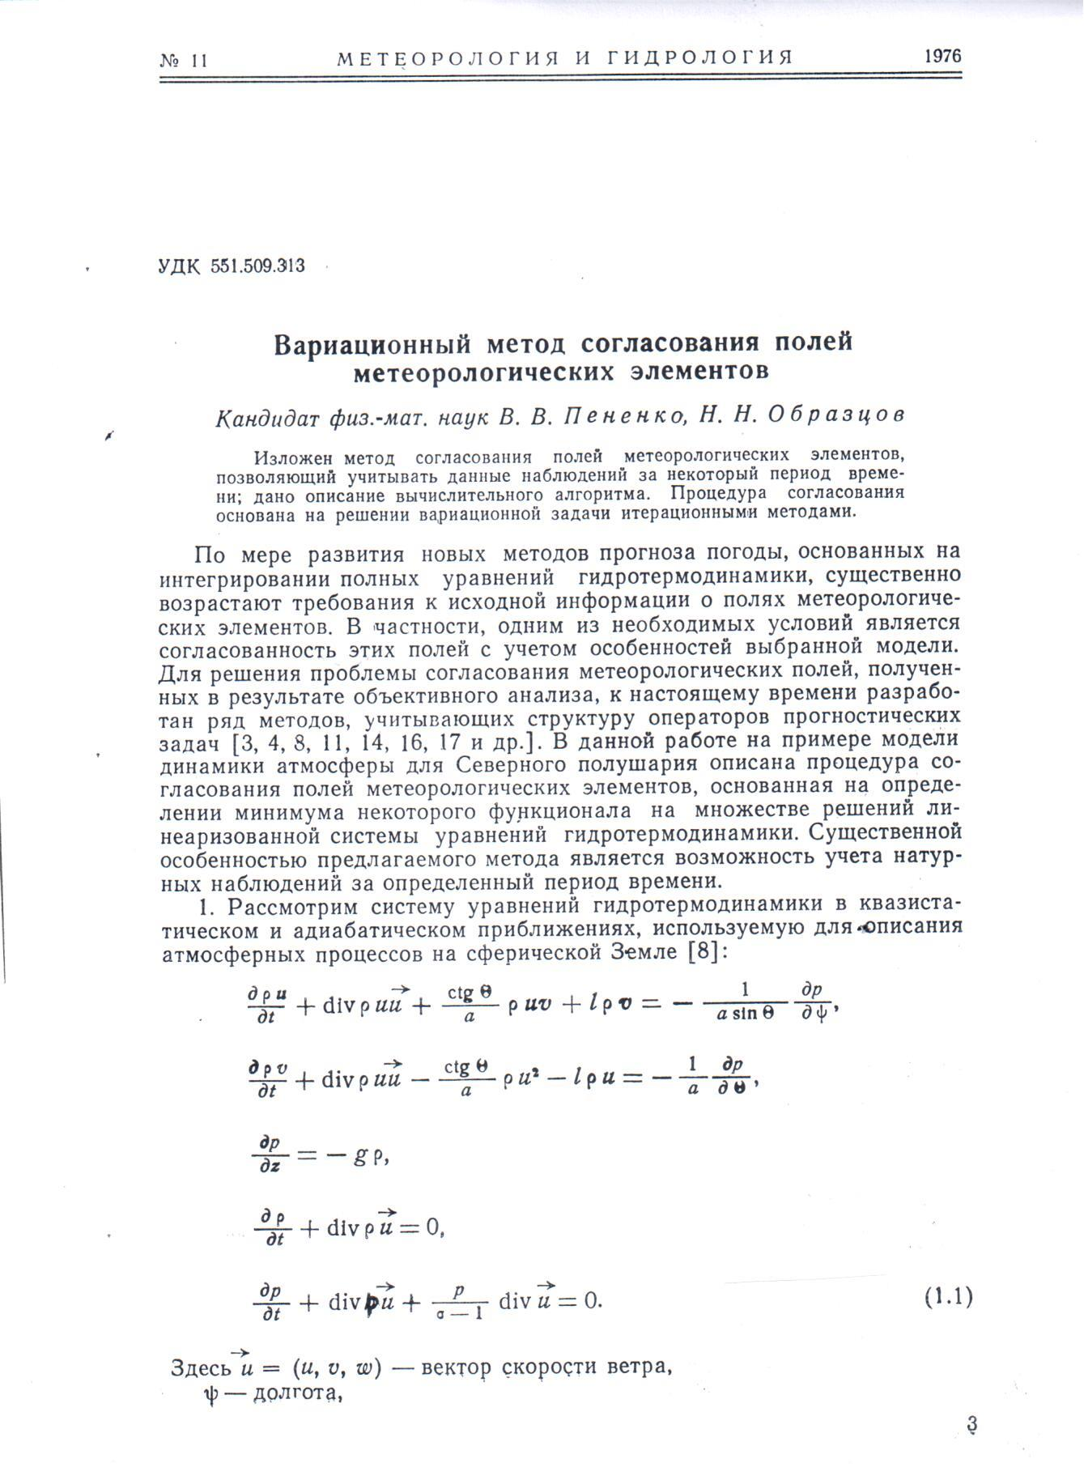
The first numerical study on variational data assimilation
(Penenko V.V., Obraztsov N.N. 1976)
Olivier Talagrand :
“The first attempt at using the adjoint approach for variational assimilation of meteorological observations was made by Penenko and Obraztsov (1976), on a simple one-level linear atmospheric model ... “
Chapter «Variational Assimilation»
In: Lahoz, W., Khatattov, B. and Menard,
(Eds.), Data Assimilation: Making sense of observations, Springer, The Netherlands, 2010

Slide 23
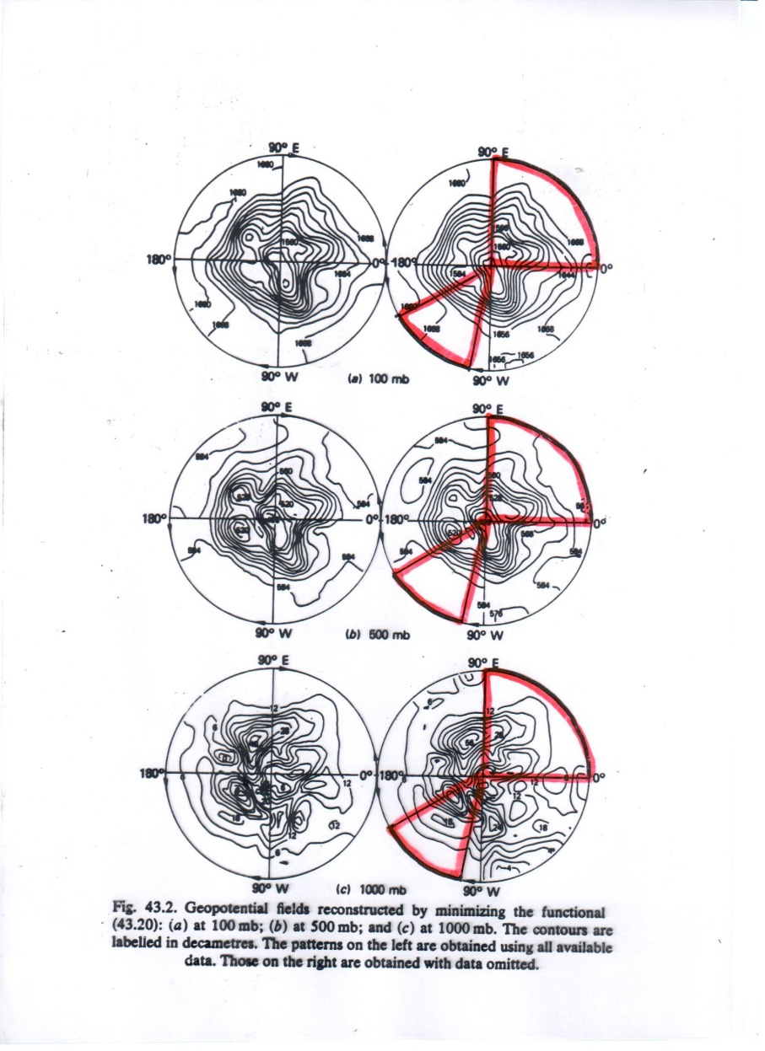
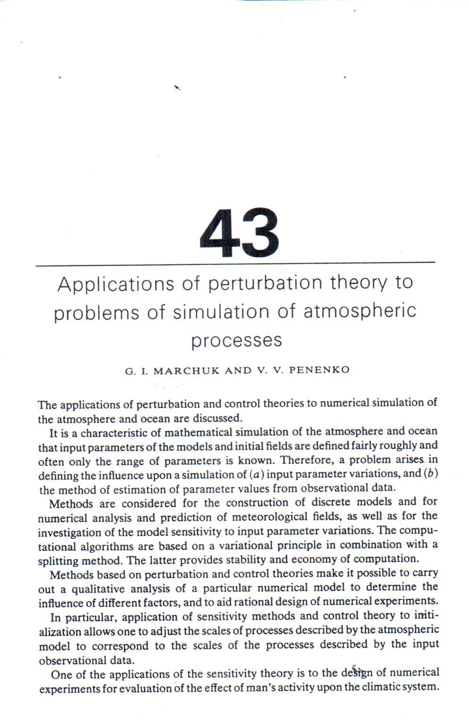
Reconstruction of the global structure of geopotential
with variational data assimilation
(without data above the world ocean)
Marchuk G.I., Penenko V.V. Application of perturbation theory to problems of simulation of atmospheric processes. In: Monsoon dynamics (Joint IUTAM/IUGG International Symposium on Monsoon Dynamics, Delhi, 1977.) Eds. J.Lighthill & R.P.Pearce. – Cambridge University press, 1981, p. 639-655.

Slide 24
Additive-averaged decomposition schemes for approximation of process models
A.A. Samarskii, P.N. Vabischevich Additive schemes for problems of mathematical
physics . M.: Nauka, 2001

Slide 25
Variational functional of the system "model - observations"

Slide 26
Direct algorithm for data assimilation in 4D model with sliding windows

Slide 27
The scenario of chemical data assimilation based on real data
The results of calculations based on the model of transport and transformation of contaminants in the atmospheric surface layer: with data assimilation ( left), without assimilation ( center), the difference between them ( right)
A complete data assimilation scenario has been compiled with meteorological data from Enviro-HIRLAM model, initial data on concentrations from MOZART model and in situ measurement data from Airbase-the European Air quality database

Slide 28
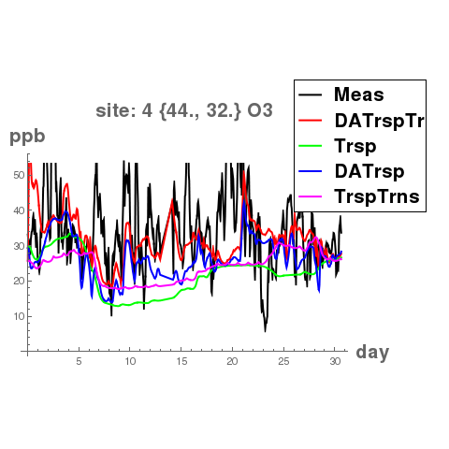
The results of ozon reconstruction in a reference site not participating in assimilation
Four scenarios:
DATrspT(rns): Transformations with data assimilation to transport processes
TrspTrns: Transformations with transport processes without data assimilation.
DATrsp: Data assimilation to transport processes without transformation.
Trsp: Transport processes (neither transformation nor data assimilation).
Meas: Measured data

Slide 30
